Slide 1
Unit 203: Electrical installations technology
Control circuits

Slide 2
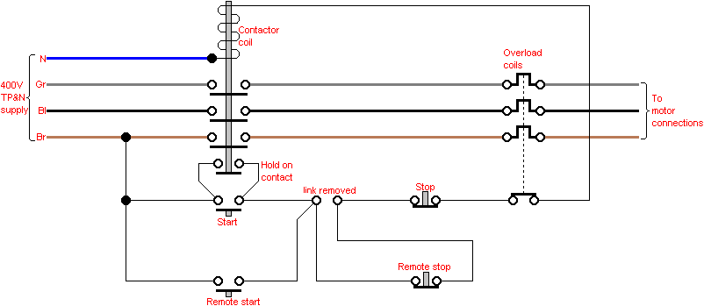
Control circuits
Direct on line (dol) starter

Slide 3
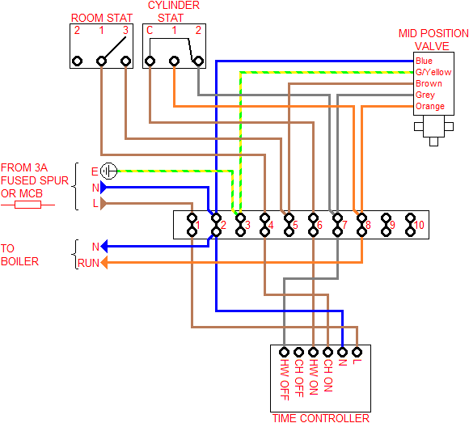
Control circuits
‘Y-Plan’ central heating control circuit

Slide 4
Unit 203: Electrical installations technology
The End

